Slide 1
Client Portfolio Rebalancing Alerts
By Gopalakrishnan Kumar, MTech IIT-Bombay,
Freelance Data Science Consultant
LinkedIn: Profile Link : https://www.linkedin.com/in/gopalakrishnankumar-a73301110/
Github:https://github.com/Gopal21236/
Kaggle URL- https://www.kaggle.com/gopalkk2

Slide 2
Google Colab URL
https://colab.research.google.com/drive/1zZCh1X9iMalC6KSznmDRDaOg1hltYvkq?usp=sharing

Slide 3
Introduction
Portfolio rebalancing is a critical aspect of investment management, ensuring that a client’s asset allocation remains aligned with their financial goals, risk appetite, and market conditions. Over time, market movements cause portfolio drift, leading to over-exposure or under-exposure in certain asset classes.
This project, Client Portfolio Rebalancing Alerts, presents a Python-based analytical framework that monitors portfolio allocation, detects deviations from target allocation, and generates rebalancing alerts. Visualization techniques are used extensively to support decision-making and client communication.

Slide 4
Objectives of the Project
The key objectives of Project 1C are:
To monitor client portfolio allocations against predefined targets
To identify over-allocated and under-allocated asset classes
To trigger rebalancing alerts based on deviation thresholds
To visualize portfolio health using analytical charts
To support proactive, data-driven portfolio management

Slide 5
Portfolio Data Overview
The simulated portfolio includes multiple asset classes such as:
Equity
Debt
Gold
Cash
For each asset, the following parameters are analyzed:
Target allocation (%)
Current allocation (%)
Deviation from target (%)
Additionally, multiple clients are simulated to demonstrate comparative portfolio analysis.

Slide 6
Rebalancing Logic
A deviation threshold is defined (for example ±5%).
Assets exceeding this threshold are flagged for rebalancing.
Positive deviation indicates over-allocation (sell/reduce).
Negative deviation indicates under-allocation (buy/increase).
This rule-based approach ensures disciplined portfolio management.

Slide 7
Role of Visualization in Portfolio Analytics
Visualization is essential for translating numerical portfolio data into intuitive insights. Graphical representations help portfolio managers and clients quickly understand risk exposure, allocation drift, and rebalancing needs without complex calculations.

Slide 8
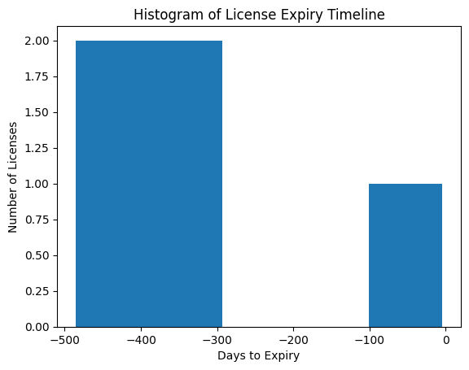
Data Visualization

Slide 9
Key Visualizations Used
6.1 Histogram – Portfolio Allocation Deviation
Purpose: To visualize the distribution of deviations from target allocation across asset classes.
Insights:
Assets clustered near zero deviation are well balanced
Assets with large positive or negative deviations indicate rebalancing urgency
Business Value:
Detects concentration risk
Helps prioritize rebalancing actions

Slide 10
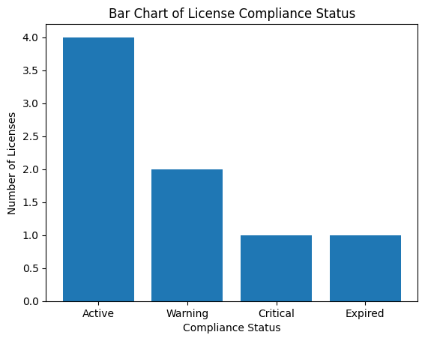
Data Visualization

Slide 11
Key Visualizations Used
6.2 Bar Chart – Target vs Current Allocation
Purpose: To directly compare target allocation with current allocation for each asset class.
Insights:
Highlights portfolio drift clearly
Identifies over-exposed and under-exposed assets
Business Value:
Improves transparency for clients
Supports justification of rebalancing decisions
hart – Target vs Current Allocation

Slide 12
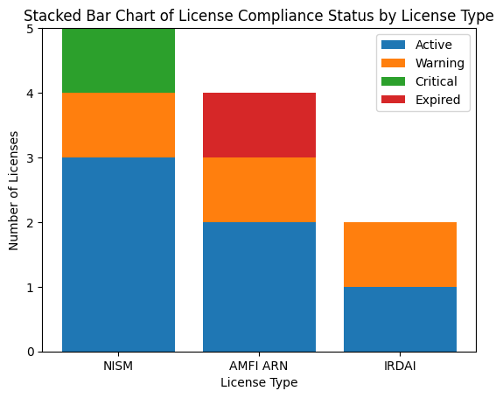
Data Visualization

Slide 13
Key Visualizations Used
6.3 Stacked Bar Chart – Allocation and Deviation
Purpose: To combine target allocation and deviation in a single visualization.
Insights:
Shows base allocation and excess/shortfall together
Makes magnitude of deviation visually clear
Business Value:
Strong visual support for buy/sell recommendations
Ideal for portfolio review meetings

Slide 14
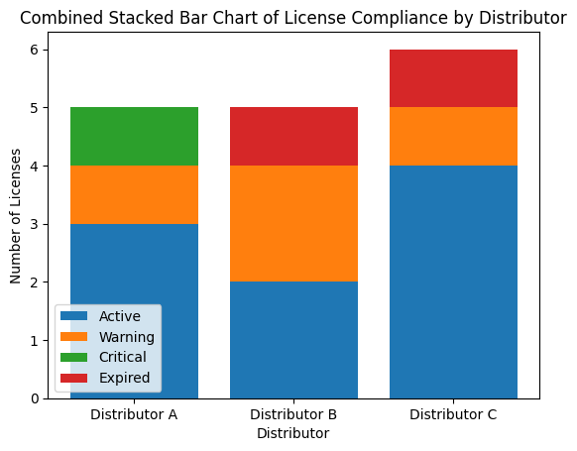
Data Visualization

Slide 15
Key Visualizations Used
6.4 Combined Stacked Bar Chart – Portfolio Rebalancing Status by Client
Purpose: To compare portfolio health across multiple clients using a single chart.
Chart Structure:
X-axis: Clients (Client A, Client B, Client C)
Y-axis: Portfolio allocation percentage
Stacks represent:
Allocation within target range
Over-allocated portion
Under-allocated portion

Slide 16
Analysis of Combined Stacked Bar Chart
Key Observations:
Clients with higher over-allocated segments face higher risk exposure
Clients with larger within-range segments exhibit disciplined portfolio management
Under-allocated segments highlight growth opportunities
Analytical Insights:
Client A shows moderate over-allocation, requiring partial rebalancing
Client B exhibits higher imbalance, indicating urgent action
Client C maintains strong allocation discipline

Slide 17
Business Impact
The portfolio rebalancing alert system delivers the following benefits:
Reduces portfolio risk due to asset concentration
Improves long-term return consistency
Enhances client confidence through transparency
Supports scalable portfolio monitoring
Enables evidence-based advisory decisions

Slide 18
Learning Outcomes
Through this project, learners gain:
Understanding of asset allocation principles
Hands-on experience with portfolio analytics in Python
Data visualization and interpretation skills
Practical exposure to wealth management workflows
Ability to design client-friendly analytical dashboards

Slide 19
Conclusion
Project 1C demonstrates how analytics and visualization can significantly enhance portfolio monitoring and rebalancing decisions. By integrating deviation analysis with intuitive visual tools such as combined stacked bar charts, the system enables proactive risk management and informed client advisory.
The approach closely reflects real-world wealth management practices and can be extended to live market data, Power BI dashboards, or automated advisory platforms.

Slide 20
Future Enhancements
Time-series portfolio drift analysis
Transaction cost–aware rebalancing
Risk-adjusted asset allocation
Power BI / Streamlit dashboards
Automated client alert notifications

